Slide 1
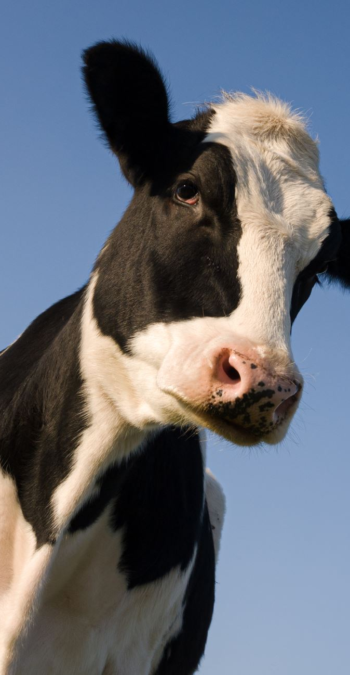
Predicting milk yield from cows using genetic markers
IOD Miniproject 3
Kay Anantanawat

Slide 2
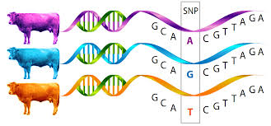
Background
DNA is the blueprint of every organism
SNPs = Single nucleotides polymorphisms
A change of one base in the DNA
Can affect the trait in the organisms even though it happens in the non-coding regions (junk DNAs).
Currently used by farmers to selectively breed the cow with the desire traits using linear regression.

Slide 3
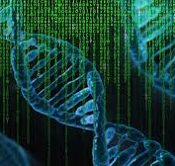
Current limitation
The amount of data is huge!
So much noise!
Other data are needed to narrow down a set of SNPs to work with.
Pedigree, the frequency of SNPs in the populations.
Not all SNPs are equal.
Strong effect – one or two SNPs
Moderate effect – small group of SNPs
Small effect – multiple groups of SNPS

Slide 4
Holestien cow is the most popular dairy cow breed in the world including Australia (Dairy Australia, n.d.). 85% of dairy cows in Australia are Holstiens. Holstein cows can potentially produce 10,000 litres of milk in a year which is equivalent to 14 cartons of 2L milk a day.

Slide 5
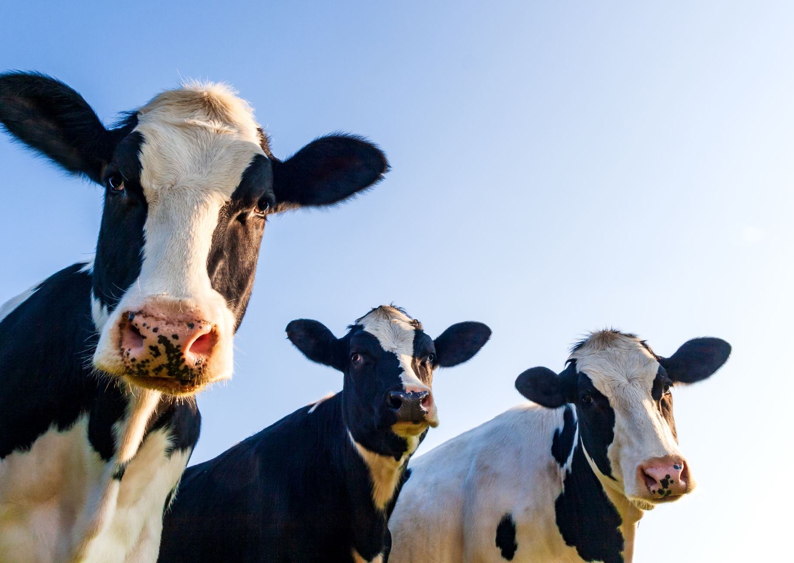
Business question
How to predict the milk production (milk yield) from the cow just by using SNPs data?

Slide 6
Data pipeline
Data cleaning
Exploratory data analysis
Model building
Remove SNPs with low diversity
Remove highly correlated SNPs
Check the distribution of the milk yield
Explore SNPs data
Split the data into test set, validation set and train set.
Build the model and adjust parameters

Slide 7
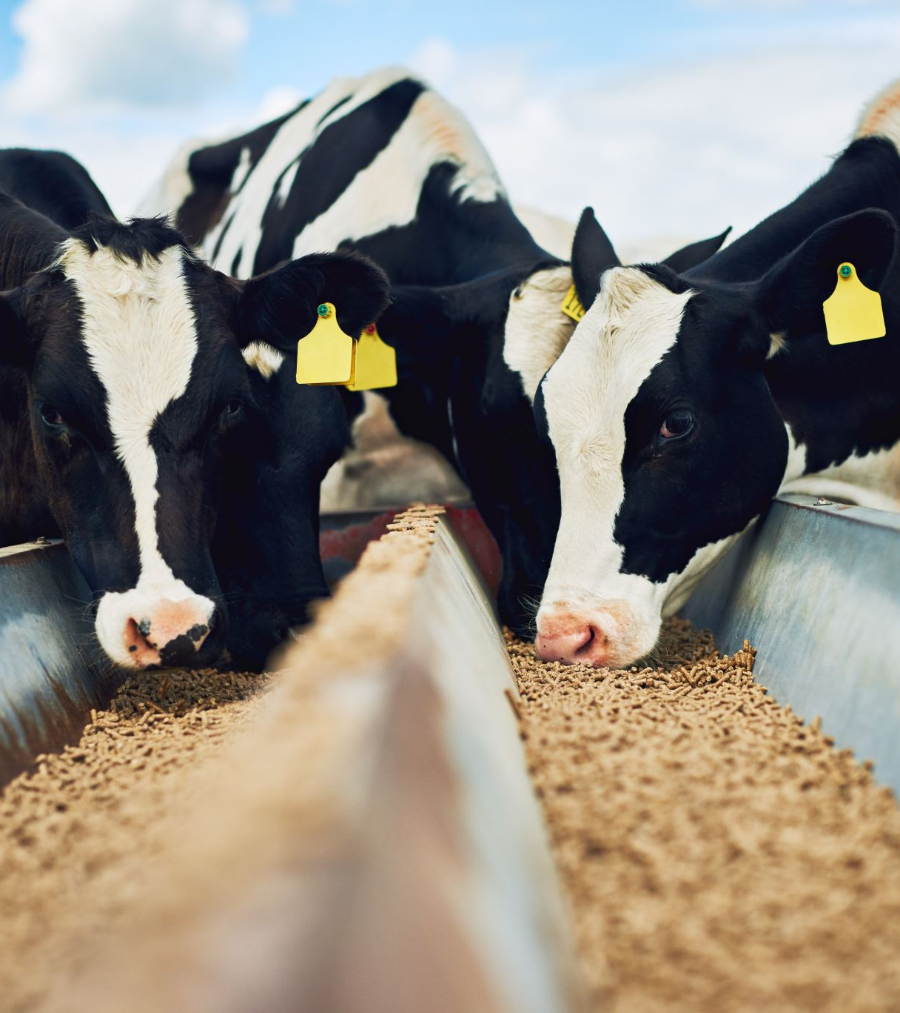
Data
The German Holstein Genomic Prediction Population
5024 bulls, provided by Vereinigte Informationssysteme Tierhaltung w.V.
42,551 SNPs
Focuses on 3 different traits:
milk fat percentage (FP)
milk yield (MY)
somatic cell score (SCS)

Slide 8
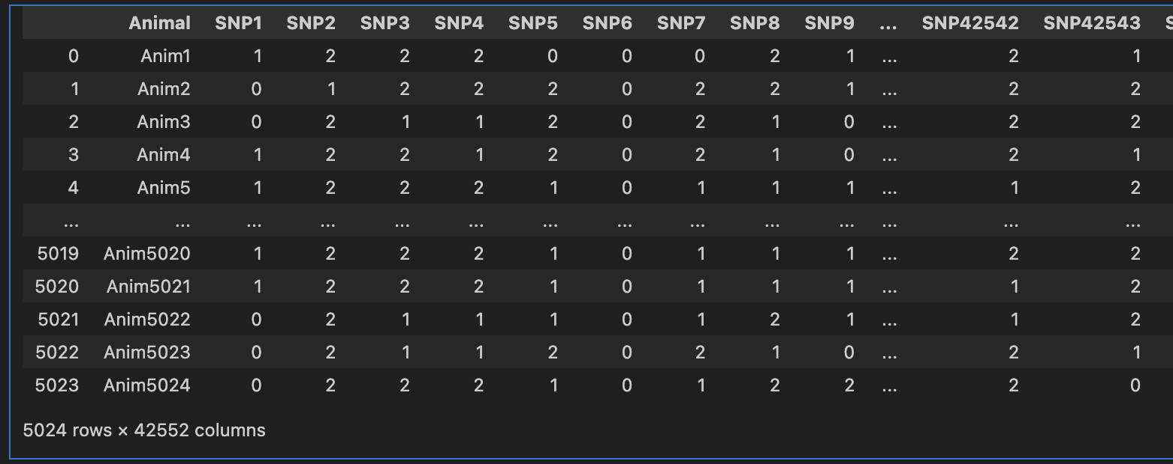
DATA
5,024 rows x 42552 features

Slide 9
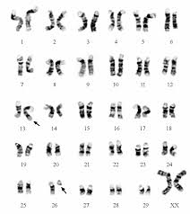
SNPs value – 0,1,2
A cow has 2 copies of genes.
The mutation is in comparison to the reference cow.
0 = No changes or mutations
1 = 1 copy contains a mutation
2 = 2 copies contain mutation

Slide 10
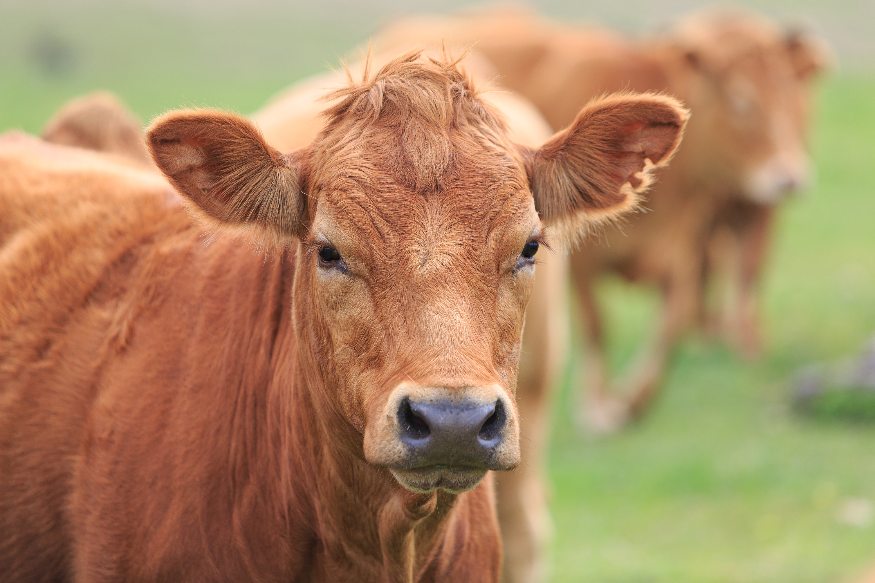
Estimated Breeding Value for Milk yield
Not preferable
reference cow
Preferable
- 3
0
+ 3

Slide 11
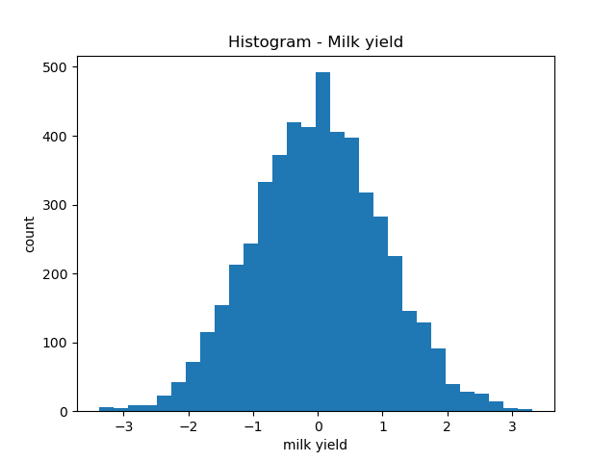
Milk yield

Slide 12
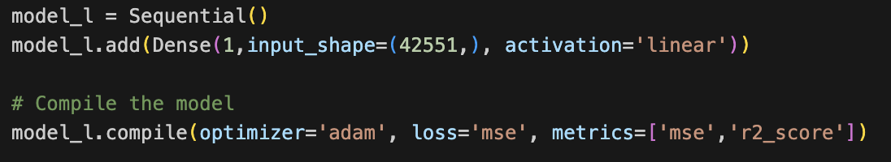
Using neuron network – 1 layer

Slide 13
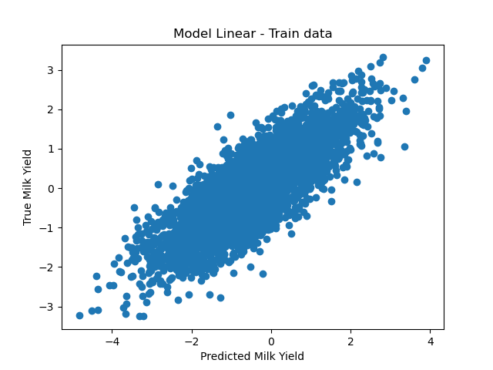
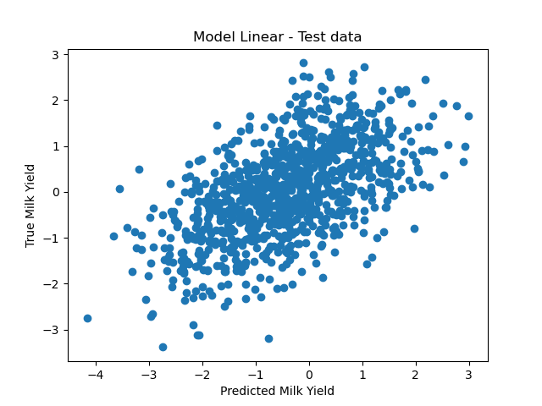
Using neuron network – 1 layer
R-square = 0.53
R-square = 0.09

Slide 14
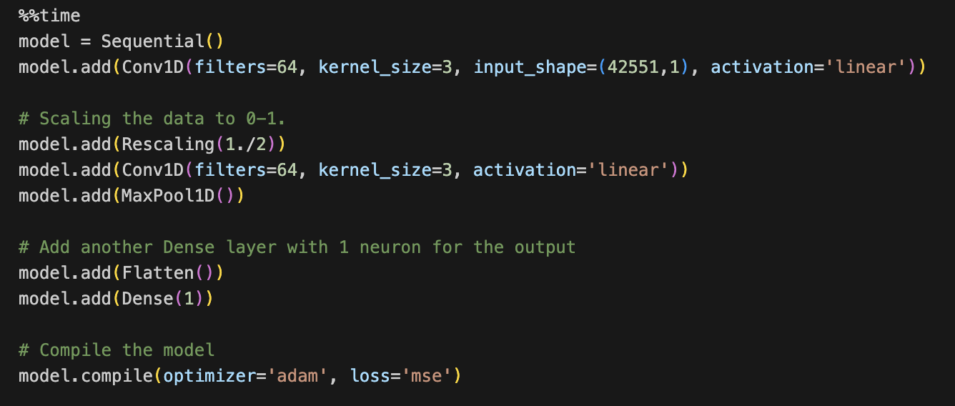
Using convolution neural network – model 1

Slide 15
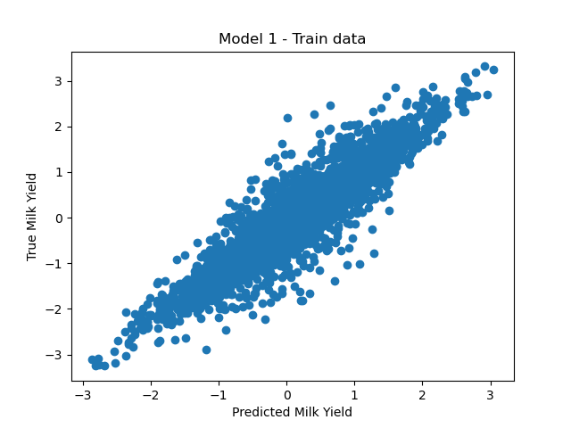
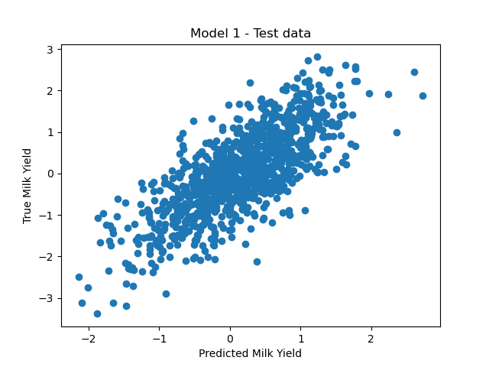
Using convolution neural network – model 1
R-square = 0.78
R-square = 0.18

Slide 16
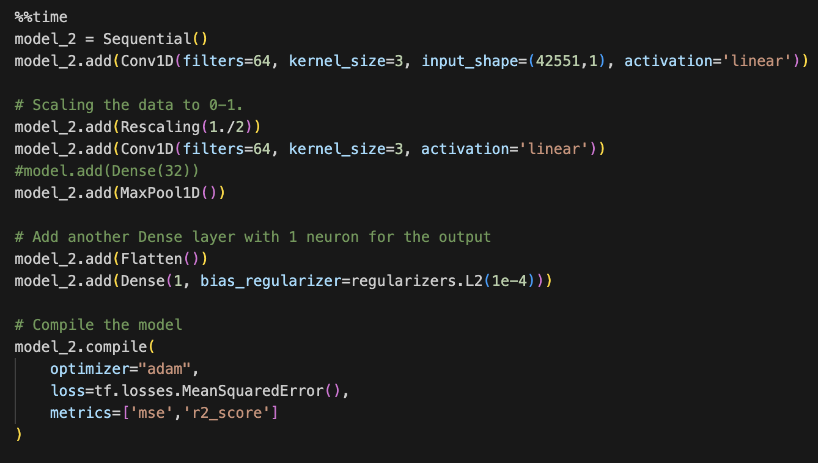
Using convolution neural network – model 2

Slide 17
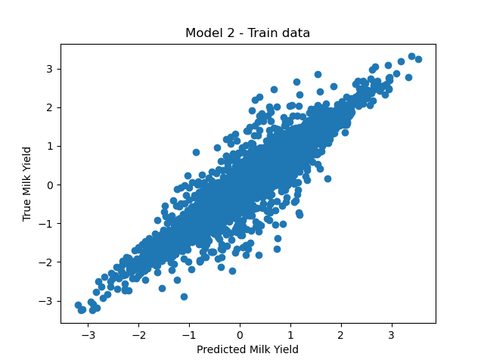
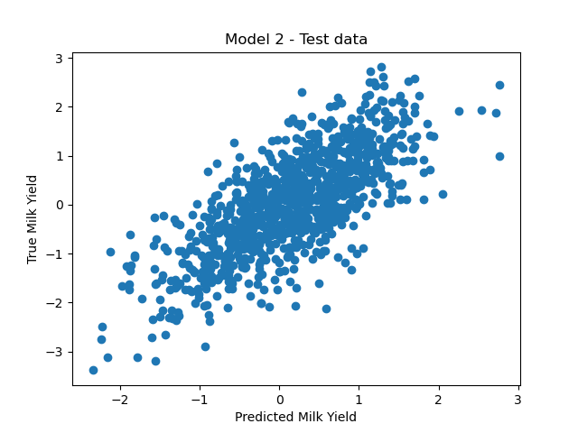
Using convolution neural network – model 2
R-square = 0.83
R-square = 0.23

Slide 18

Pros and Cons
Pros:
It is easy to implement. Only a set of SNPs are needed for the prediction.
Cons:
Black box – we don’t know which genes play a big part for each trait.
cow

Slide 19


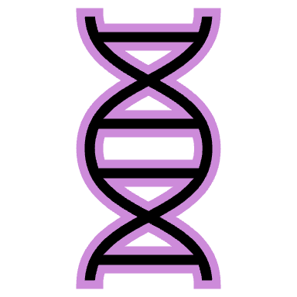


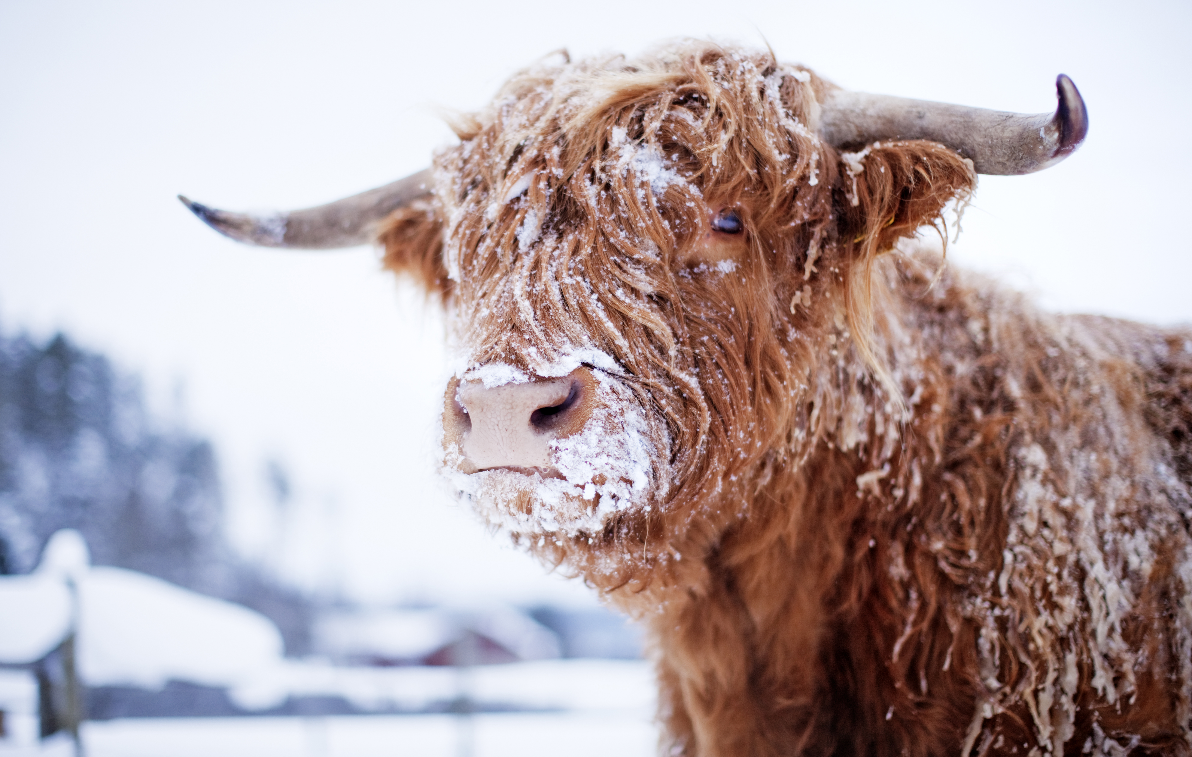


Model solution
X

Slide 20
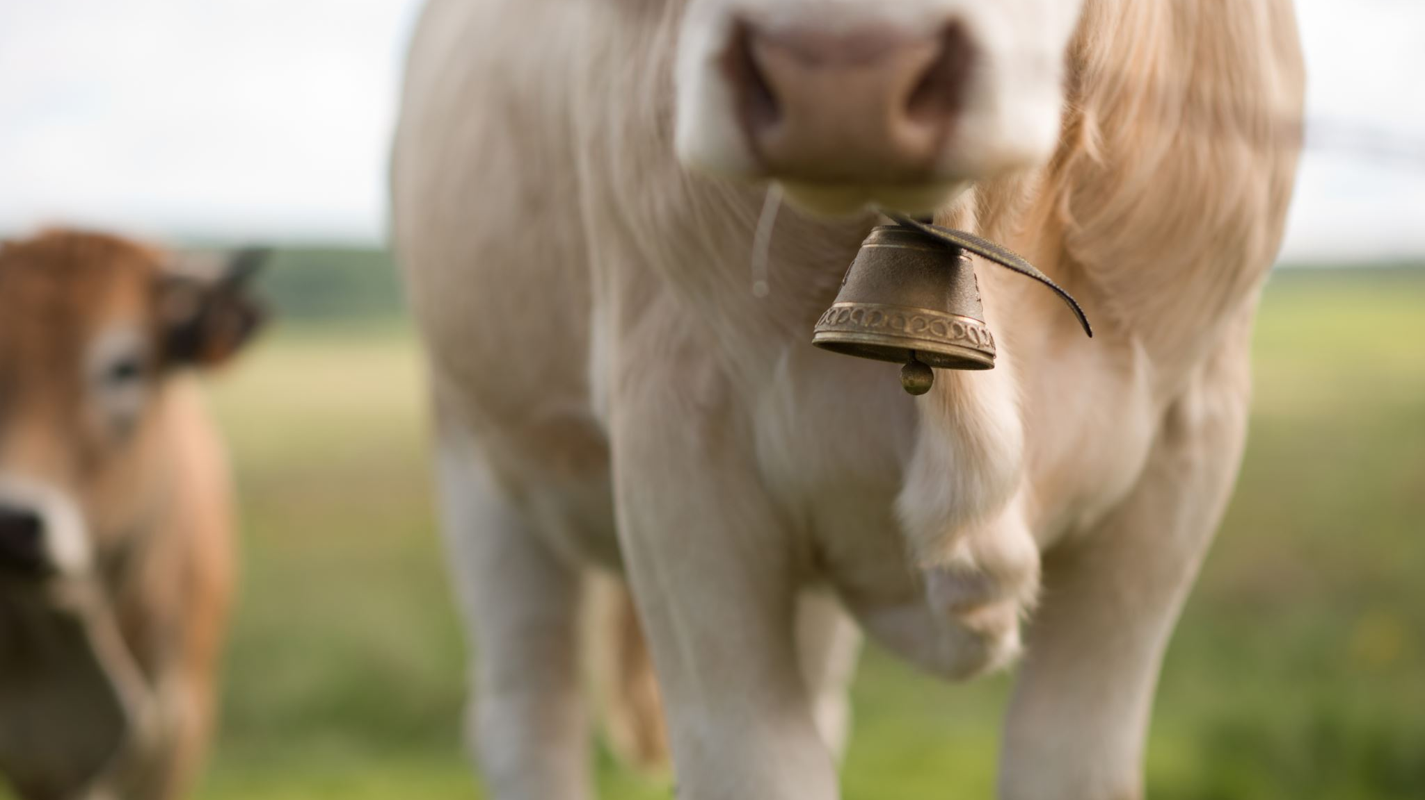
Next
Refine the model to solve overfitting.

Slide 21
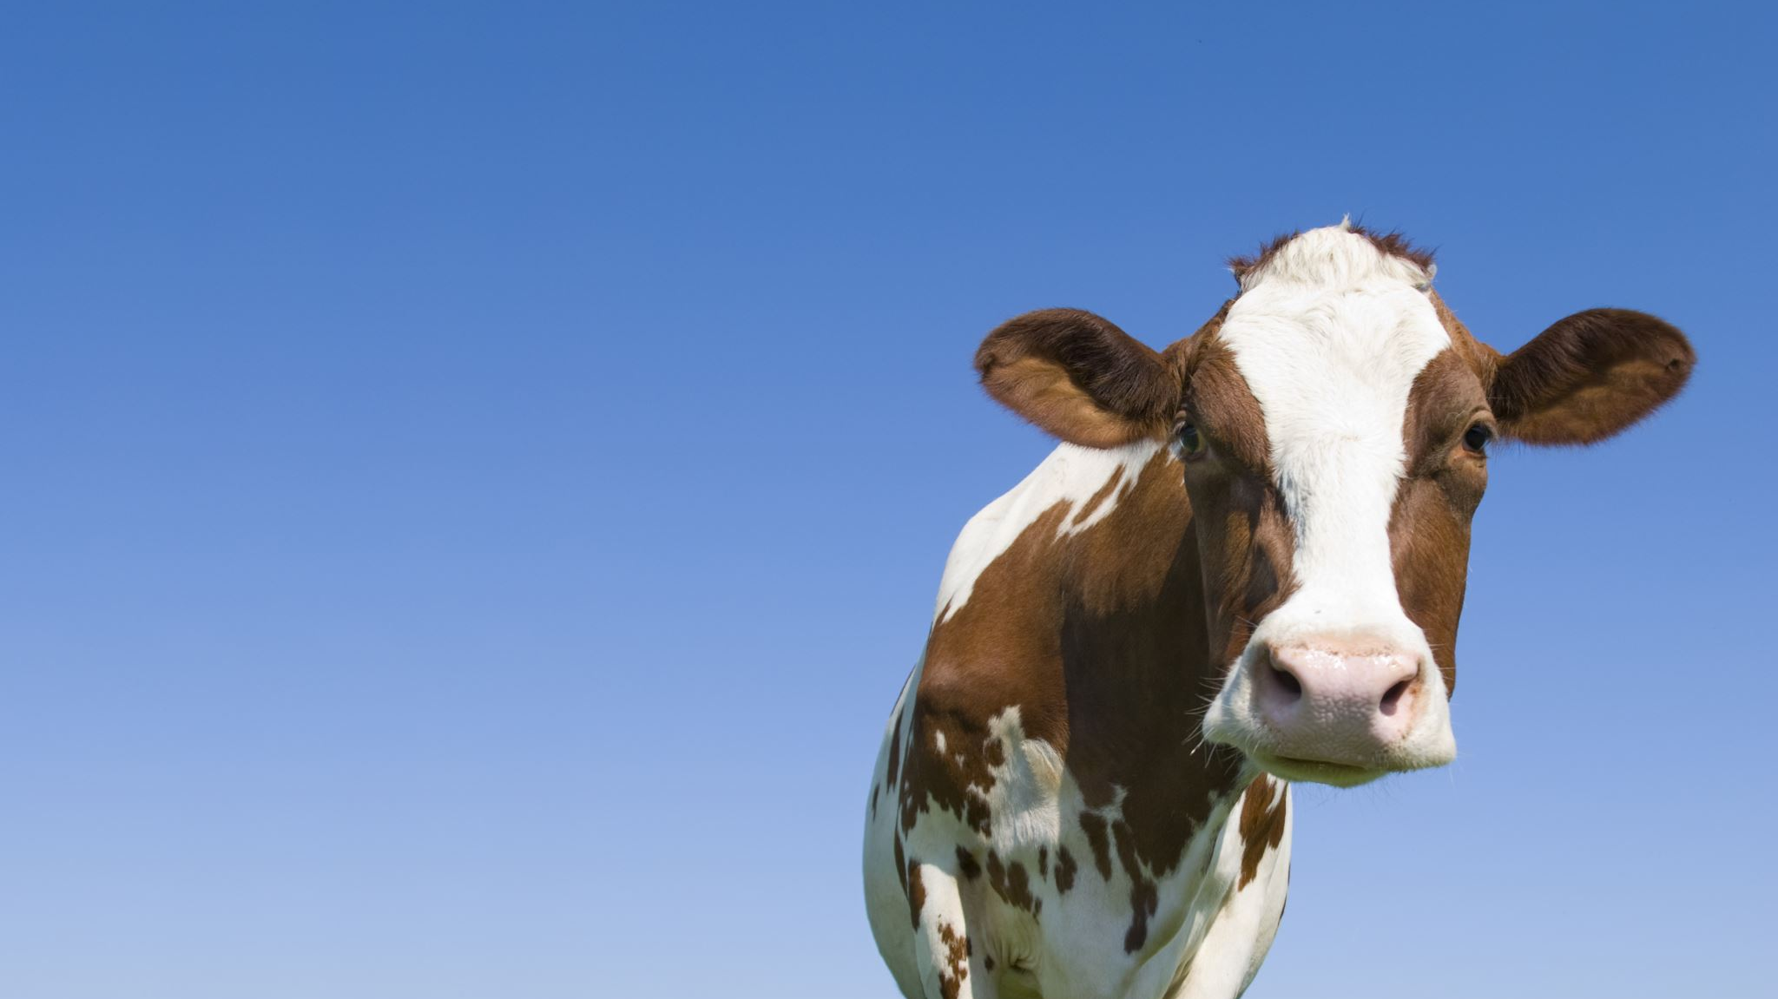
Q&A

